Slide 1

Sekou Tyler

Slide 2
Recap
What is a dimension
What is a measure/fact
What is the basic form of data modeling called?
Why is understanding data modeling important?

Slide 3
The History of Data Visualization

Slide 4
Every day we create 2.5 quintillion (10¹⁸) bytes of data - so much that 90 percent of the world's data today has been created in the last two years alone.
-IBM CMO Study, 2011

Slide 5
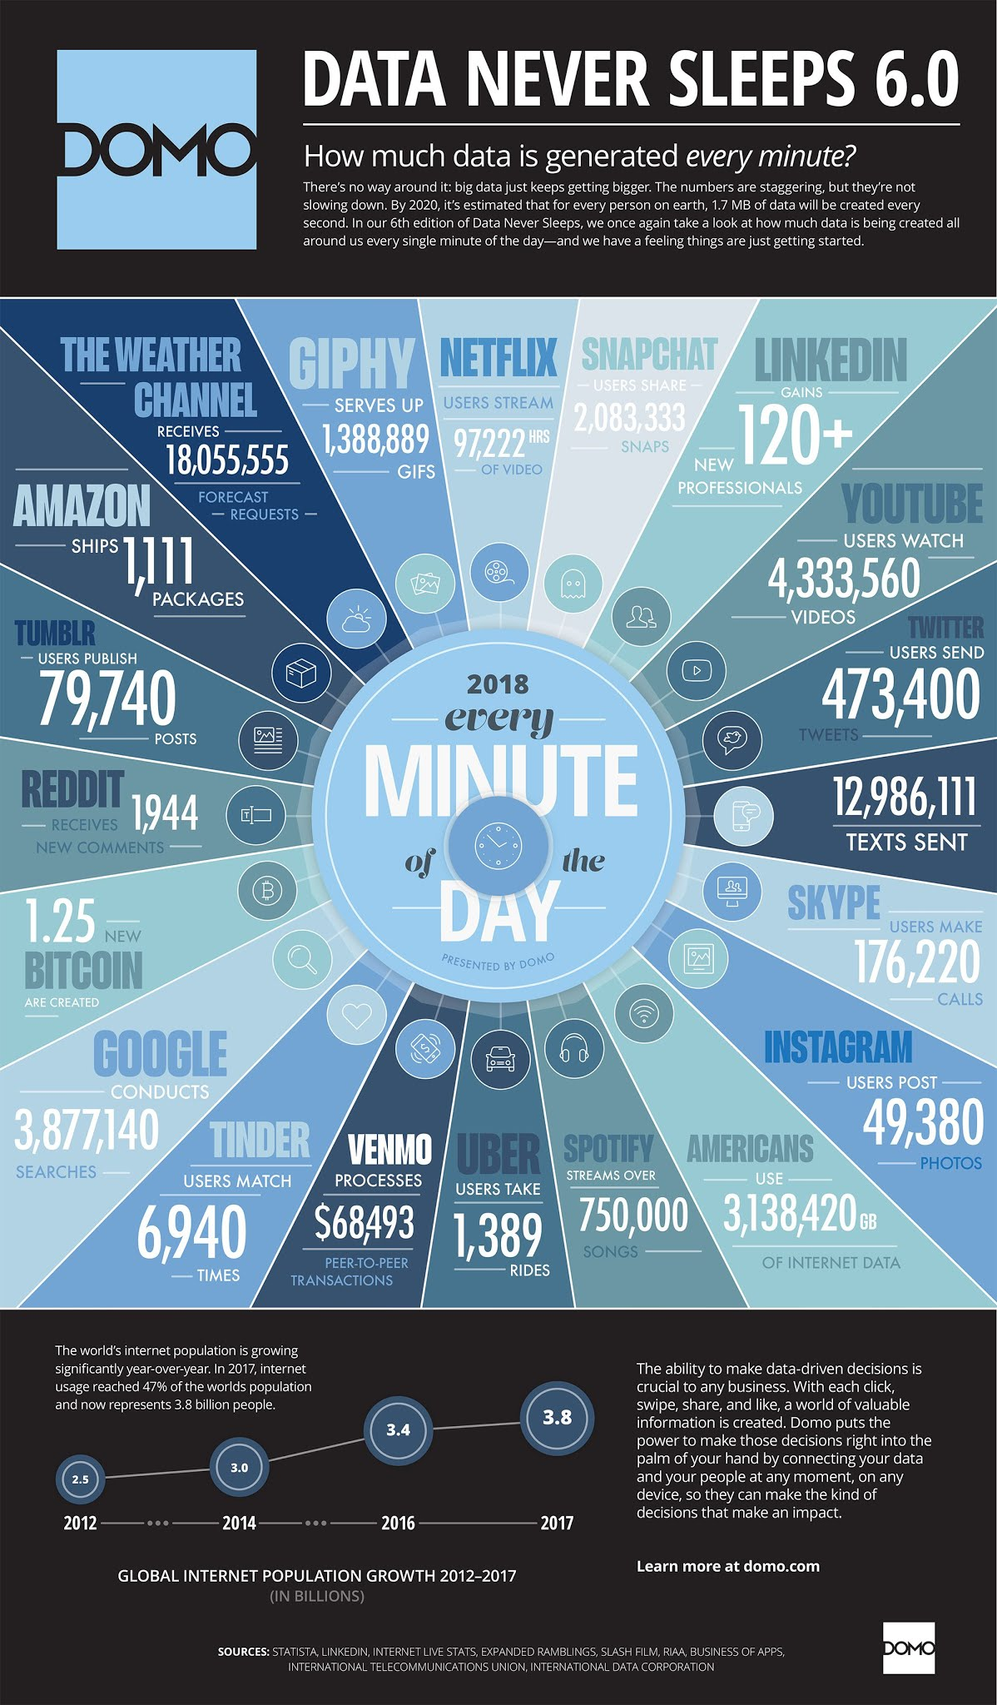

Slide 6
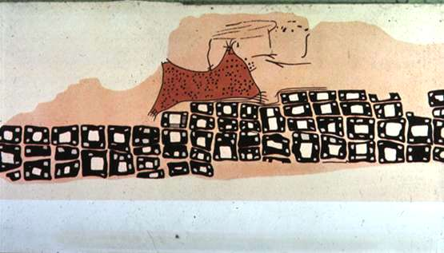
Çatalhöyük – 6200 BC

Slide 7
Consider Your Audience
Decision maker? What’s known?
Relevant background info?
Default Biases?
What data should be used?
Is audience familiar with the data?
Risk? Do we need hedge them upfront?
What will they use it to do?
What does success look like?
One sentence test.

Slide 8
Storyboarding
Problem
-What are we trying to solve
Who
-Audience
-You
What
-Action
Mechanism
-Tableau
-PowerPoint?
-Power BI?
-Excel?
Tone
-Success/Failure?
How
-Possible types of graph/chart
Source: storytelling with data: a data visualization guide for business professionals (Wiley 2015)

Slide 9
Different Types

Slide 10
Two main types of data visualization
Exploration
Explanation

Slide 11
Exploration
Discover new areas of interest
Pose new questions
Discover new stories

Slide 12
Explanation
Answer a question
Support a decision
Convey information
Increase efficiency

Slide 13
Two main types of data
Qualitative
Quantitative

Slide 14
Qualitative
Can also be categorical
Favorite color = blue
Gender, State, etc.

Slide 15
Quantitative
Expressed in numbers and can be counted and aggregated easily
Fully additive facts

Slide 16
How we see the world

Slide 17
The need to visualize data
"Use a picture. It's worth a thousand words.“
-Tess Flanders, 1911

Slide 18
The need to visualize data
Human brain processes images 60,000x faster than text.
-Persuasion and the Role of Visual Presentation Support: The UM/3M Study, 1986
90 percent of the information transmitted to the brain is visual.
-MIT News, January 16, 2014

Slide 19
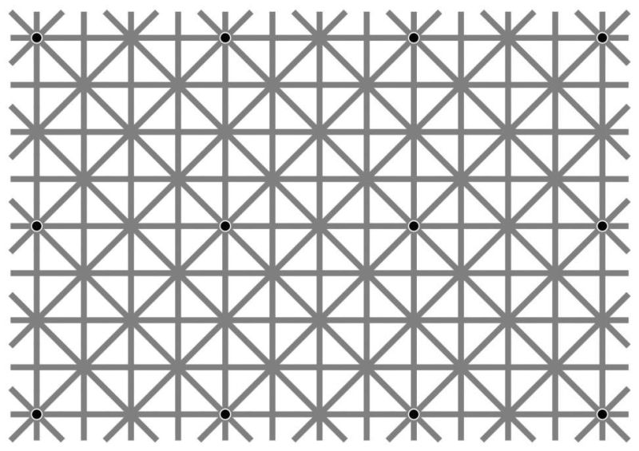
How many dots do you see?
Ninio’s Extension Illusion

Slide 20
How many dots do you see?
There are 12 dots. It is difficult to see all of the dots because the grid prevents us from seeing the whole picture. If we removed the grid we could see all 12 dots, but when presented on a grid, our perception changes entirely.
“Our visual system is lazy. Regular patterns are tempting because you can look at a small portion and think you have the whole thing figured out”- Martinez-Conde
Ninio’s Extension Illusion

Slide 21
The Gestalt Principles

Slide 22
Gestalt
Introduced by Christian von Ehrenfels
Psychological term meaning unified whole
The whole is different (not greater) than the sum
Gestalt Effect –
Ability of the mind to generate whole images from a collection of parts

Slide 23

Law of Pragnanz

Slide 24
Law of Pragnanz

Slide 25
Law of Pragnanz

Slide 26
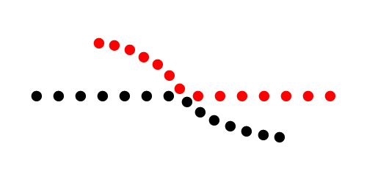
Law of Continuity

Slide 27
Law of Continuity

Slide 28
Law of Continuity

Slide 29
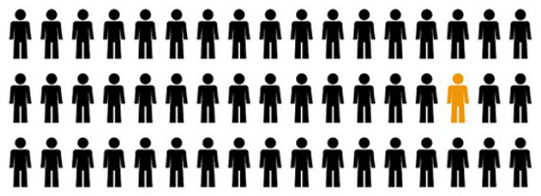
Law of Similarity

Slide 30
Law of Similarity

Slide 31
Law of Similarity

Slide 32

Law of Focal Point

Slide 33
Law of Focal Point

Slide 34
Law of Focal Point

Slide 35

Law of Proximity

Slide 36
Law of Proximity

Slide 37
Law of Proximity

Slide 38
Colors

Slide 39
Colors
We don’t see the same thing.
They have innate meanings and feelings

Slide 40

Normal Vision

Slide 41

Deuteranopia

Slide 42

Protanopia

Slide 43

Tritanopia

Slide 44
What can we do?
Be conscious of red and greens together.
Find a CVD friendly palette when possible.
Shading and gradients!
Use help!
The Colorlab - http://colorlab.wickline.org/colorblind/colorlab/
Coblis - http://www.color-blindness.com/coblis-color-blindness-simulator/

Slide 45
Pitfalls to Avoid
Not engaging the audience or user first!
Visual Clutter – Keep it Simple
Color Abuse
Poor Design
Bad Data
Pie Charts ☺

Slide 46
Resources
Gestalt Psychology – http://en.wikipedia.org/wiki/Gestalt_psychology
Color Matters – http://www.colormatters.com
CVD Color Lab - http://colorlab.wickline.org/colorblind/colorlab/
Coblis - http://www.color-blindness.com/coblis-color-blindness-simulator/
Data Visualization Catalogue - https://datavizcatalogue.com/search.html

Slide 47
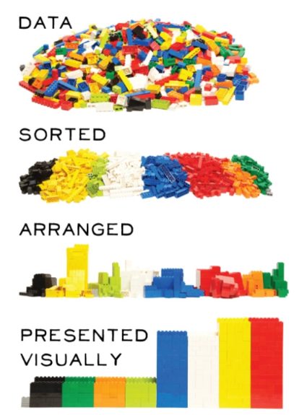

Slide 48


Slide 49
What is Tableau

Slide 50
What is Tableau
Tableau is a suite of products that enables anyone to create, collaborate and captivate. Tableau compliments your natural ability to understand data visually.
“Tableau helps people see and understand their data.”

Slide 51
Tableau Product Family

Slide 52


Tableau Public
Visualize and Share Your Data in Minutes – For Free
http://bit.ly/tabpublic

Slide 53

Tableau Desktop
Answer questions as fast as you can think
http://bit.ly/tabdesktop

Slide 54

Tableau Reader
Answer questions as fast as you can think
http://bit.ly/tabreader

Slide 55

Tableau Online
TABLEAU ONLINE
Rapid-fire Cloud BI. Whenever, wherever.
TRY IT FREE
http://bit.ly/tableauonline

Slide 56

Tableau for Students
http://bit.ly/tabstu

Slide 57

Tableau for Non-Profits
Our mission is to encourage the use of facts and analytical reasoning to solve the world’s problems
GET IT NOW
http://bit.ly/tabnonprofit

Slide 58
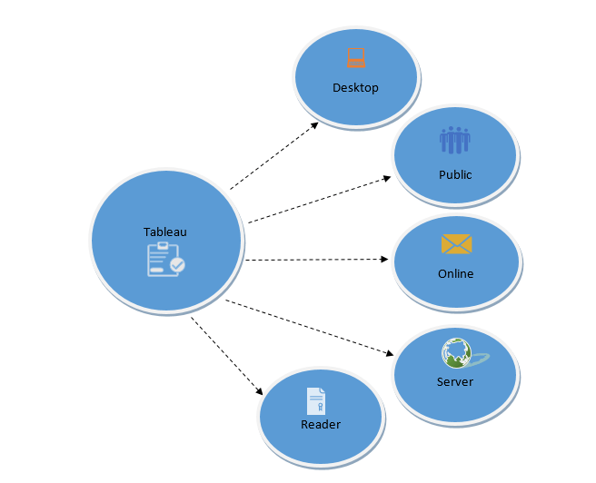
Tableau Public
Source: https://www.guru99.com/what-is-tableau.html

Slide 59
Tableau: Pros and Cons
Pros:
Top of the line visualization capabilities
Multiple Data Connections
https://help.tableau.com/current/pro/desktop/en-us/exampleconnections_overview.htm
High Performance
The tool also operates fast even on big data, which makes its powerful performance an important point in the list the advantages of Tableau.
Community
Large online and in person community
Mobile-Friendliness
Tableau Mobile has been downloaded more than 50000 times in Google play store
Cons:
Tableau Public is free, but only connects to Excel files and can only be shared to the public.
Tableau Server and other products have much higher cost in comparison to other tools.
Higher Learning Curve for Non Technical Users
No custom visual imports
Static and single value parameters
Very difficult to automate and update parameters on a dashboard.
Formatting for a lot of columns is very time consuming
Tableau’s conditional formatting and limited 16 column table displays are pain points for users. No way to change formatting for multiple columns at once.

Slide 60
Tableau: Definitions
A worksheet contains a single view along with shelves, cards, legends, and the Data and Analytics panes in its side bar. For details on the worksheet workspace, see The Tableau Workspace.
A dashboard is a collection of views from multiple worksheets. The Dashboard and Layout panes are available in its side bar. For more details about creating dashboards, see Dashboards.
A story contains a sequence of worksheets or dashboards that work together to convey information. The Story and Layout panes are available in its side bar. For more details about creating stories, see Stories.
A worksheet is where you build views of your data by dragging and dropping fields onto shelves.
A dashboard is a combination of several views that you can arrange for presentation or to monitor.
A story is a sequence of views or dashboards that work together to convey information.

Slide 62
Create a map with the highest sales per state
Create a chart that shows the sales per year
Create a chart showing the top 5 subcategory
Create a chart showing the lowest selling product
Create a visual showing all sales
Allow the end user to filter by year

Slide 63
Create a map with the highest profit per state
Create a chart that shows the profit by month and year
Create a chart showing the bottom 5 products
Create a chart showing the highest selling product
Create a visual showing states with the lowest amount of sales
Allow the end user to filter by city

